Slide 1


Capital Agent
Built for Beginners. Powered for Pros.
WeHack 2025 | Timeless Moments Awaits

Slide 2
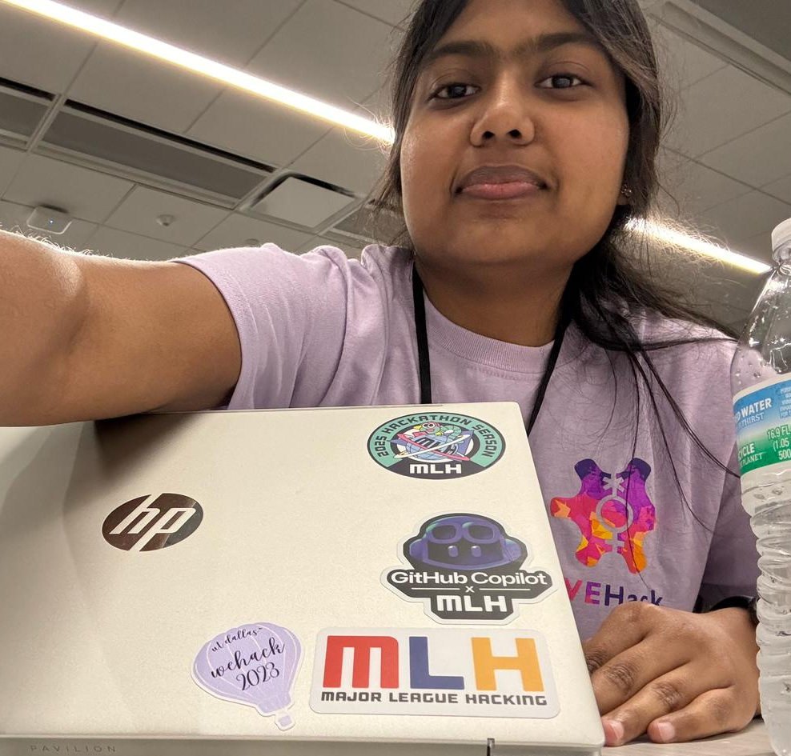



Agents
Varsha
Harshitha
Nanddanaa
Chinmayi

Slide 3
Vision - Problem Statement
People struggle with investment decisions due to hidden risks
Our goal: Make real estate + stock investing smart, safe, and personal
Capital Agent = AI detective for your financial future

Slide 4
Features
Property risk + trend analysis
Stock sentiment + future performance
Personalized chatbot (Gemini + MongoDB memory)
Smart diversification suggestions

Slide 5







Tech Stack

Slide 6
Demo

Slide 7
Future Plans
Integrate a functional frontend with developed design
Make the chat bot more conversational and customised to personal profile
Use person’s historic data to recommend better

Slide 8
What are we proud of
Beginners in fintech and developing websites
Built everything end-to-end in under 15 hours
Works for both property and stock domains

Slide 9
What Went Wrong
Google GenAI v1beta versioning nightmares
Multiple package conflicts and re-installs
Integrating Gemini + MongoDB memory took time

Slide 10
Thank you
Thank you

